Slide 1

PREDICTIVE ANALYSIS OF RETAIL SALES: FURNITURE AND HOME FURNISHINGS
Overview of Project Report
Domain Application of Predictive Analytics
Presented By: OLUWATOBI EKUNDAYO
(x19173105)
Lecturer-in-Charge: VIKAS SAHNI

Slide 2


Introduction
The “coronavirus recession” caused by the outbreak of a pandemic this year (2020) caused a drastic decline in sales and business operations including the retail sales of furniture products and home furnishings.
This report evaluates the applied techniques to carry out predictive analysis for the furniture and home furnishings domain of the retail industry. The result of the prediction shows that the impact of coronavirus (COVID-19) will affect retail sales of furniture for the next 24 months, after which sales will begin to recover.
Business insights based on predictive analysis for IKEA Furniture are also presented in this report to provide management or decision makers of the business with valuable insights for strategic planning to increase sales.

Slide 3

Project Objectives
To predict retail sales of furniture for the next 2 years (24 months)
To critically analyse the historical data to extract past, current, and futuristic insights of significant business value for the business domain (furniture retail sales).
Evaluate different models applicable to predicting retail sales of furniture.
Develop a model with significant accuracy for predicting furniture retail sales

Slide 4
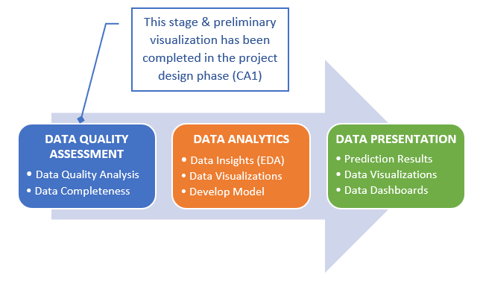
Strategy implemented to analyse the dataset

Slide 5
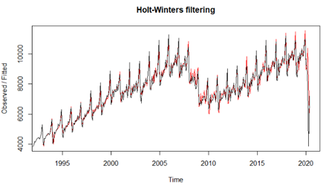
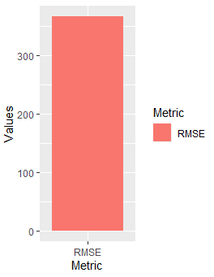
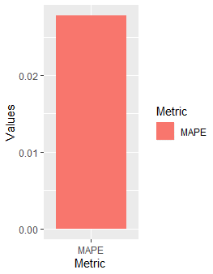
Applied Technique & Evaluation
Technique Used: Holt-Winters Method
Original vs Forecasted
Evaluation Metrics
RMSE: 366.45
MAPE: 0.03
January 1992 – June 2020

Slide 6
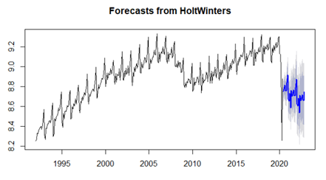
Model Prediction
Forecast Results
The time series data exhibits strong, regular growth and pronounced, approximately multiplicative seasonality
Forecast of retail sales of furniture will not recover fully within the next two years. Hence, more strategies will be required to jump-start the recovery of retail sales.
Furniture retail sales have been seen to be at its peak in November and December for each year. Therefore, more efforts will be required to strategically increase and maximise retail sales by November and December of year 2020.
Furniture retail sales have been seen to be at its lowest in January and February for each year.
Time Series Forecasts
24 months prediction
(July 2020 – May 2022)

Slide 7





KEY BUSINESS INSIGHTS
Products under the “Table & desk” category were purchased the most. Due to the pandemic (covid-19), many businesses/organisations have transitioned to working from home (Home-Office). Hence, a strategic marketing campaign for this category can increase sales of the corresponding and related products.
Products under the “Sofas & armchairs” category generated the most in sales. This can be attributed to the longer time spent at home. Hence, a strategic marketing campaign to appeal to customers need for comfort or luxury, can increase sales of products in this category.
Customers preference for furniture products available in other colours should be considered to increase sales. This is because 46.13% of total furniture sales in year 2020 was for products sold in other colours.

Slide 8

KEY BUSINESS INSIGHTS
More products designed by Ehlén Johansson, IKEA of Sweden, Ola Wihlborg, and Francis Cayouette should be made available, as top 3 furniture product designers had sales well-over $200,000. Also, furniture designs by a collaboration of either of the designers could attract more sales with the right marketing strategy.
As part of the plans to recover from the recession, more focus can be given to the top 10 furniture products in sales to sustain the business income generation.
99% of the furniture products was sold online. This perfectly indicates the use of internet by consumers during this pandemic period for purchasing the products. Therefore, more strategy should be put in place to maximise online platforms, through use of digital ads, online promotions etc.

Slide 9
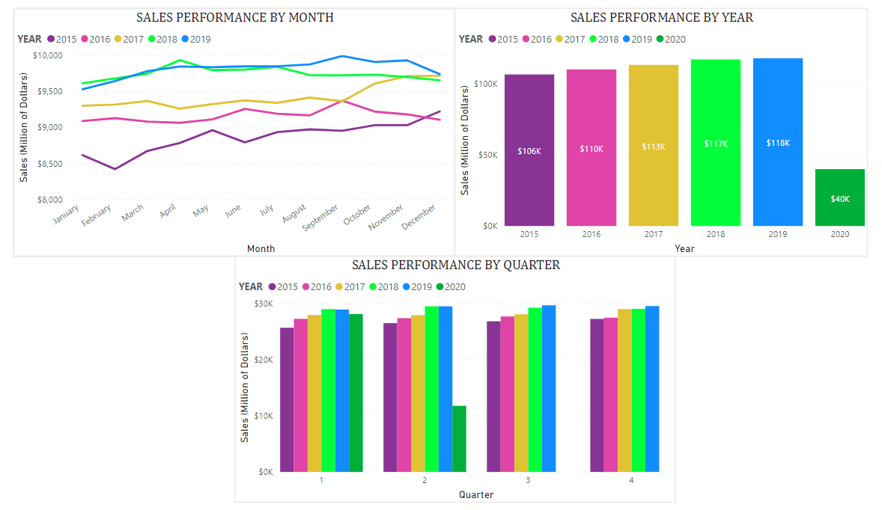
Data DASHBOARD
Performance Dashboard

Slide 10
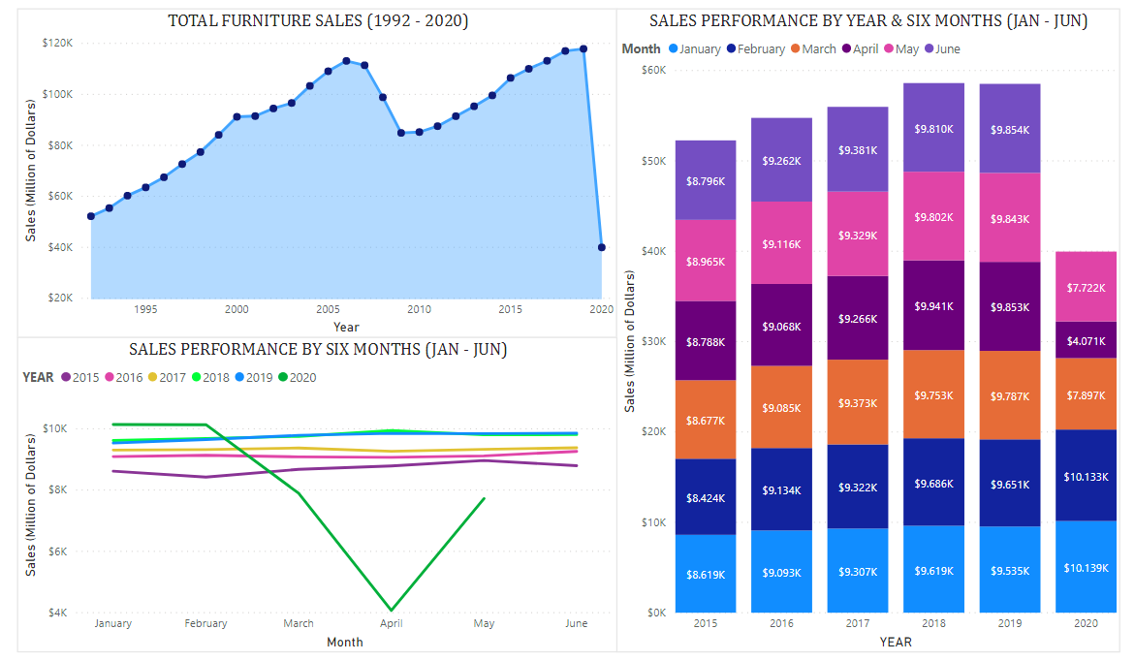
Data DASHBOARD
Performance Dashboard

Slide 11
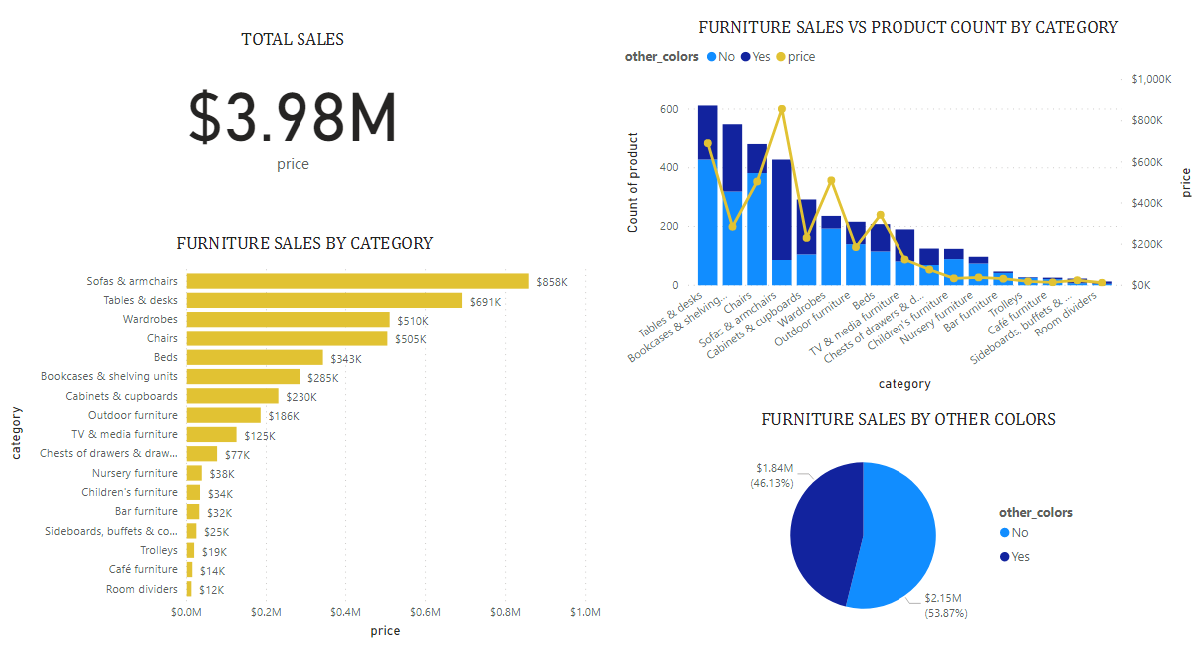
Data DASHBOARD
Sales Dashboard

Slide 12
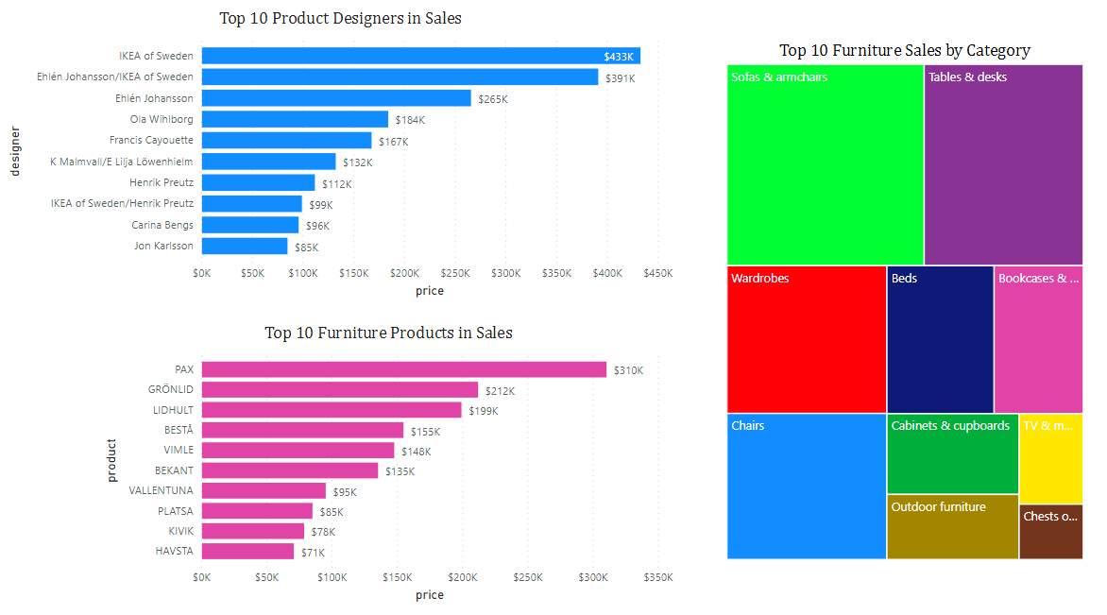
Data DASHBOARD
Sales Dashboard

Slide 13
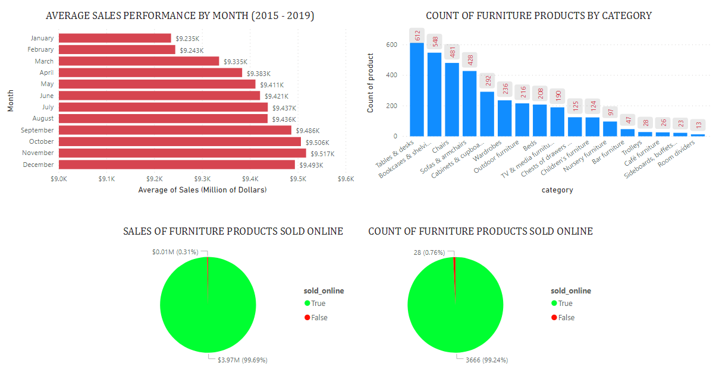
Data DASHBOARD
Sales Dashboard

Slide 14
THANK YOU

